Slide 1
Computer Vision - Day 2
Dr Prashant Aparajeya

Slide 2
Transfer Learning
Concept: Transfer learning involves taking a model that was trained on one large, diverse dataset (like ImageNet) and using its learned features to solve a different but related task. Instead of training a model from scratch, you reuse the pre-trained model as a “feature extractor.”
How It Works:
Feature Extraction:
Freeze Layers: You load the pre-trained model and freeze most (or all) of its layers. This means that during training on the new task, the weights of these layers remain unchanged.
New Classifier: You remove the original classifier (usually the final fully connected layers) and replace it with a new classifier tailored to your new task (e.g., a different number of output classes).
Training: Only the new classifier’s weights are updated during training.

Slide 3
Transfer Learning – Example
Imagine you have a pre-trained ResNet-50 model trained on ImageNet, and you want to classify types of flowers. You’d:
Remove the last fully connected layer of ResNet-50.
Freeze all the convolutional layers (so they keep their learned representations).
Add a new fully connected layer that outputs, say, 5 classes (for 5 flower types).
Train only this new layer on your flower dataset.
This approach is especially useful when your new dataset is small because the pre-trained layers already contain powerful feature representations.

Slide 4
Fine-Tuning
Concept: Fine-tuning is a more refined version of transfer learning where you not only replace the classifier but also “unfreeze” some of the pre-trained layers and train them on your new dataset. This allows the model to adapt its learned features to better fit the specifics of the new task.
How It Works:
Initial Transfer:
You start with a pre-trained model and usually follow the same steps as in transfer learning by replacing the final classification layer.
Selective Unfreezing:
Instead of keeping all the pre-trained layers fixed, you unfreeze some of the later layers (or sometimes all layers) so that their weights can be updated during training.
Typically, a lower learning rate is used for these layers to avoid large changes that could erase the valuable pre-trained information.
Training:
The entire network (or at least the unfreezed portion along with the new classifier) is then trained on the new dataset.

Slide 5
Fine-Tuning – Example
Using the same ResNet-50 for flower classification:
You replace the final layer as before.
Initially, you might freeze all layers and train the new classifier.
Once the classifier has learned basic distinctions, you unfreeze the last two or three residual blocks and continue training (with a low learning rate). This fine-tuning step allows the model to adjust its higher-level feature representations for the specific characteristics of the flower images.
Fine-tuning generally results in higher performance than simple feature extraction because it tailors the model’s representations more closely to the new domain, but it requires more data and careful training to avoid overfitting.

Slide 6
Summary of Differences
Transfer Learning (Feature Extraction):
Use Case: When you have limited data and want to leverage a robust feature extractor.
Training: Only the newly added classifier layers are trained; the rest of the network remains unchanged.
Example: Using a pre-trained model to classify flower types by only training a new output layer.
Fine-Tuning:
Use Case: When you have more data or need the model to adapt more closely to the new task.
Training: Some or all pre-trained layers are updated along with the new classifier, typically using a lower learning rate.
Example: Unfreezing the last few layers of a pre-trained model for flower classification so the feature extraction adapts to the nuances of the new dataset.

Slide 7

Fun Quiz
Your task is to calculate the total number of weights and biases in a simple CNN with the following architecture:
Input: 32x32x3 RGB image
Conv1: 16 filters of size 3x3, stride 1, padding 1
MaxPool1: 2x2, stride 2
Conv2: 32 filters of size 3x3, stride 1, padding 1
MaxPool2: 2x2, stride 2
Fully Connected: 128 neurons
Output: 10 classes
Form a team of 3.
You have 7 mins
Raise Your hands when done.
The top 3-groups will have the chance to present their answers on the board.

Slide 8
Answer
3. Convolutional Layer 2 (Conv2)
Input: 16×16×16
Filters: 32 filters of size 3×3
Depth per filter: 16
Weights per filter: 3 × 3 × 16 = 144 weights Bias per filter: 1
Total parameters in Conv2:
32 × (144 weights + 1 bias) = 32 × 145 = 4640
2. Max Pooling 1 (MaxPool1)
Operation: 2×2 pooling with stride 2
Effect on dimensions: Reduces spatial dimensions by a factor of 2
Output size after pooling: Since we use same padding for the convolution, the output from Conv1 remains 32×32×16. After pooling, the dimensions become:
32/2 × 32/2 × 16 = 16 × 16 × 16
(Note: Pooling layers have no weights or biases.)
1. Convolutional Layer 1 (Conv1)
Input: 32×32×3
Filters: 16 filters of size 3×3
Depth per filter: 3 (because the input is RGB)
Weights per filter: 3 × 3 × 3 = 27 weights Bias per filter: 1
Total parameters in Conv1:
116 × (27 weights + 1 bias) = 16 × 28 = 448
6. Output Layer
Input from FC layer: 128 neurons
Output classes: 10
Weights in output layer:
128 × 10 = 1280
Biases in output layer: 10 (one per class)
Total parameters in output layer:
1280 + 10 = 1290 1280+10=1290 (No Padding)
4. Max Pooling 2 (MaxPool2)
Operation: 2×2 pooling with stride 2
Effect on dimensions: Reduces spatial dimensions by a factor of 2
Output size after pooling: The output from Conv2 (with same padding) remains 16×16×32. After pooling, the dimensions become:
16/2 × 16/2 × 32 = 8 × 8 × 32
(Again, pooling layers do not contribute parameters.)
5. Fully Connected (FC) Layer
Input from previous layer: Flatten the 8×8×32 output
8 × 8 × 32 = 2048 neurons
Neurons in FC layer: 128
Weights in the FC layer:
2048 inputs × 128 neurons = 262144
Biases in the FC layer: 128 (one per neuron)
Total parameters in FC layer:
262144 + 128 = 262272
Total Number of Parameters
Now, sum up the parameters from all layers:
Conv1: 448; Conv2: 4640; FC: 262272; Output: 1290
Total = 448 + 4640 + 262272 + 1290 = 268650

Slide 9
Dropout
Dropout is a regularization technique that helps prevent overfitting by randomly “turning off” (i.e. setting to zero) a fraction of a layer’s activations during training.
In essence, by temporarily removing some neurons on each forward pass, the network is forced to learn redundant, robust representations that do not overly rely on any single neuron.
This idea has proven especially useful in deep networks where overfitting can be a major problem.

Slide 10
Dropout in CNN
Why Use Dropout?
Prevent Overfitting: By randomly dropping neurons during training, dropout reduces the chance that the network memorizes the training data.
Reduce Co-Adaptation: Neurons cannot rely on the presence of particular other neurons to detect specific features, so they learn more general features.
Special Considerations in CNNs:
Spatial Correlation: In convolutional layers, adjacent pixels (or features) are highly correlated. Dropping individual neurons (as in fully connected layers) might not be as effective because nearby activations still carry similar information.
Dropout2d: For CNNs, it is common to use a “channel-wise” dropout (implemented as nn.Dropout2d in PyTorch) that zeroes out entire feature maps rather than individual elements. This helps to force independence across channels and better regularize the convolutional features.
For example, you might see dropout applied after a pooling layer or after a convolutional block to reduce overfitting while preserving spatial structure.

Slide 11
How Dropout Works in PyTorch
During Training: When you call model.train(), dropout layers randomly zero out elements with a specified probability (e.g., p=0.5). To maintain the overall magnitude of the activations, the surviving elements are scaled by a factor of 1/(1−p) so that the expected sum remains the same.
During Evaluation: When you switch to evaluation mode using model.eval(), dropout is automatically deactivated; the layer acts like an identity function and no neurons are dropped. This ensures that at test time all the learned features are utilized.
Dropout vs. Dropout2d:
nn.Dropout is typically used for fully connected (linear) layers where each neuron is dropped independently.
nn.Dropout2d (or spatial dropout) is designed for convolutional layers and drops entire channels (feature maps) at once. This is beneficial for CNNs where spatially adjacent pixels share a lot of information.

Slide 12
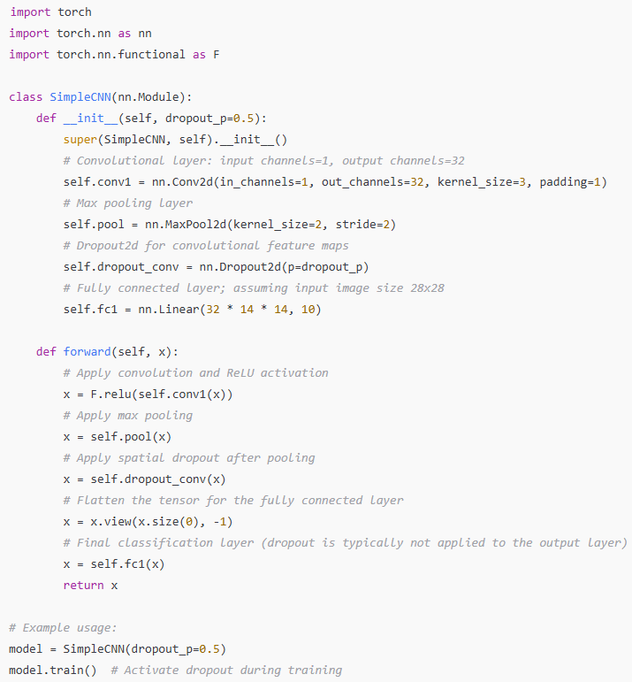

Slide 13
Dropout
Dropout is used to prevent overfitting by randomly disabling neurons during training.
In CNNs, it is more effective to use dropout methods like Dropout2d, which drops whole channels, because of the spatial correlations in convolutional features.
PyTorch offers both nn.Dropout (for linear layers) and nn.Dropout2d (for convolutional layers) with automatic behavior switching between training and evaluation modes.
When building your model, you typically insert dropout layers after activation or pooling layers (and before fully connected layers, if desired) to improve generalization

Slide 14
Batch normalization
Batch normalization is a technique that normalizes the inputs to a layer in a neural network during training.
This helps to reduce internal covariate shift (the change in the distribution of network activations due to the updating of parameters in previous layers), which in turn speeds up training and improves stability.

Slide 15
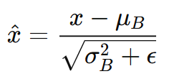

How Batch Normalization Works
Normalization: For each mini-batch during training, batch normalization computes the mean μB​ and variance σ^2 for each feature (or channel). Then, each input x is normalized as:
​​
Here, ϵ is a small constant (like 10^(−5)) added for numerical stability.
Scaling and Shifting: After normalization, batch normalization introduces two learnable parameters, γ (scale) and β (shift), which allow the network to undo the normalization if needed. The final output is:
These steps allow each layer to learn on a more stable distribution of inputs, leading to faster convergence and often better overall performance.

